Slide 1





Blockchain functionality summary
Blockchain functionality summary
Smart Contract Development with Solidity
SoftUni Team
Technical Trainers
Software University
http://softuni.bg
Logos: https://www.ethereum.org/assets

Slide 2



Table of Contents
Decentralization
Blockchain structure
Blockchain consensus
PoW, PoS
Mining
A blockchain node
Blockchain explorers
2

Slide 3



Notes:
Трите горещи теми в днешни дни

Slide 4

What is a cryptocurrency
Decentralized network
Exchange of digital tokens
Protected with cryptography
Anonymous, but public
and transparent
Built ontop of Blockchain tech.
No centralized control

Slide 5
Problem with decentralization
Pesho
Bank
Gosho
5 BGN
4,50 BGN
Notes:
Проблемът с централизираните банки

Slide 6
Cryptocurrencies – no intermediary
Pesho
Gosho
5 BGN
Notes:
Контролът отива в ръцете на потребителите

Slide 7
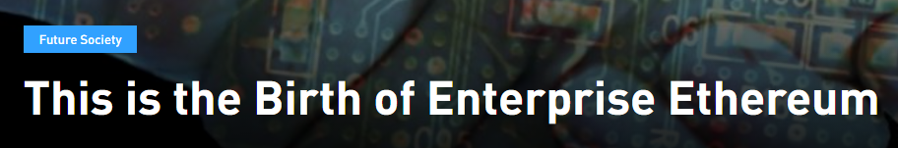
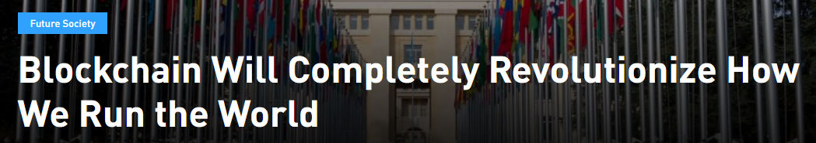
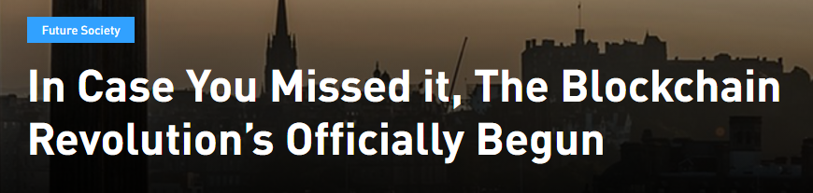

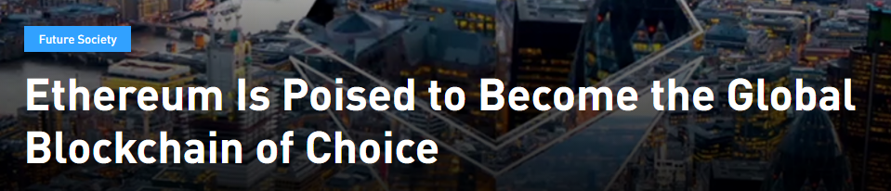





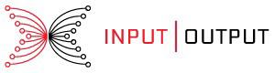
The reaction

Slide 8
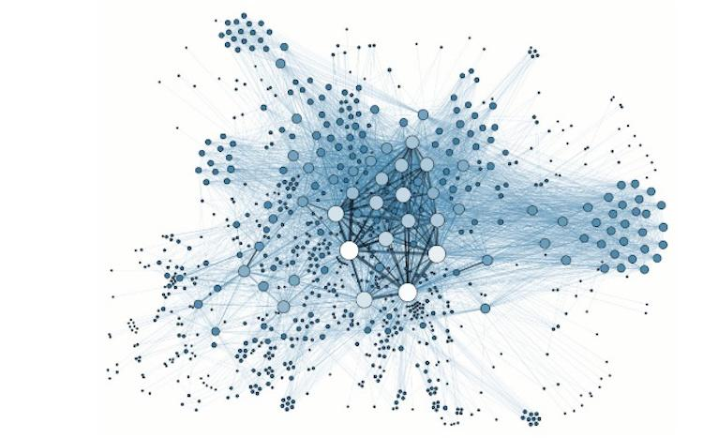
Notes:
Мрежата на криптовалута е съвкупност от компютри, свързани по децентрализиран и дистрибутиран начин.
Съдържат същите данни (блокчейн) и изпълняват същия код
Мрежата и сигурна, 100% uptime.

Slide 9
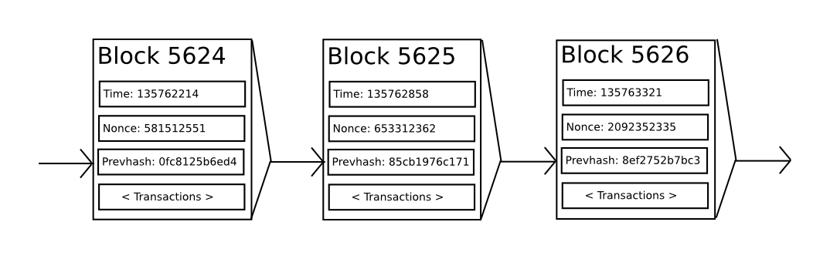
Blockchain
Notes:
Decentralized, distributed database
Event driven architecture
Blocks cannot be changed – anything on the blockchain is a confirmed fact
Data in the blockchain is immutable – one can only append to the blockchain

Slide 10
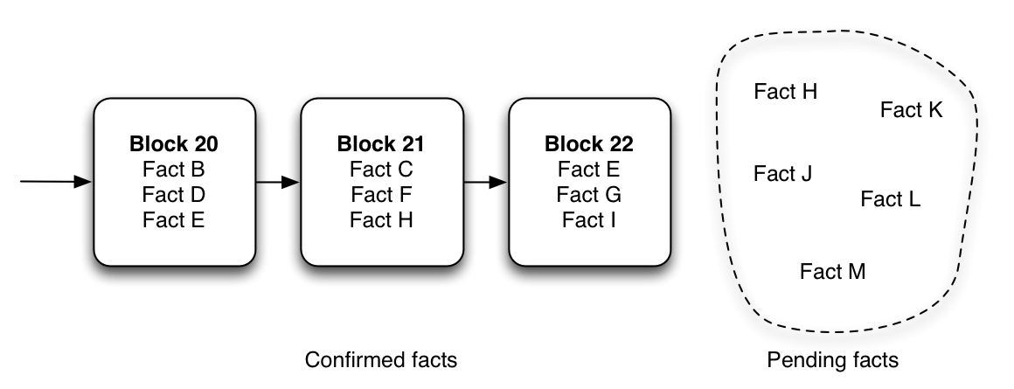
Notes:
Поради сигурността и децентрализацията, всичко вече в блокчейна е факт и закон.

Slide 11
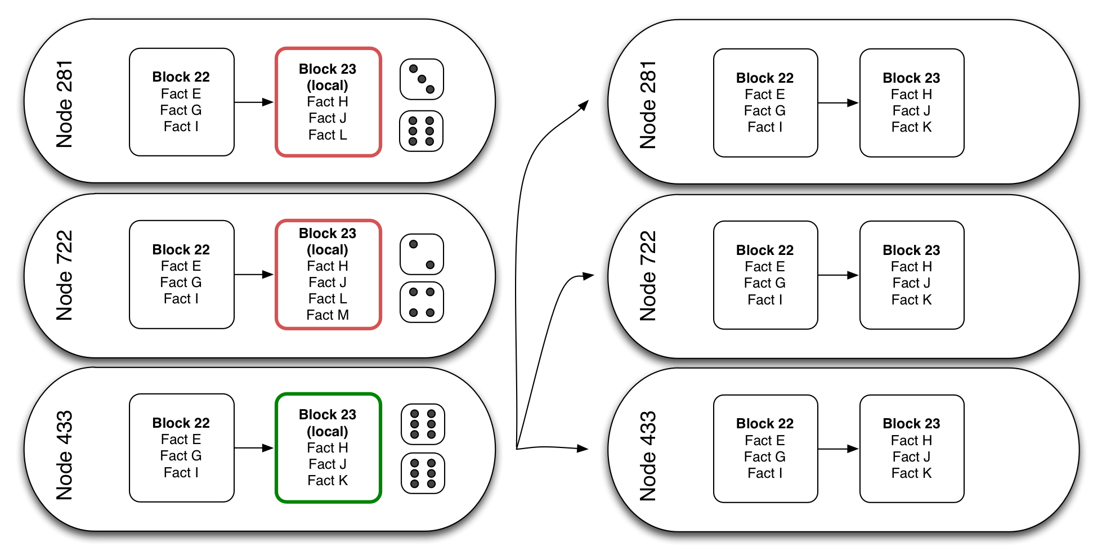
Notes:
Майнинг процесът

Slide 12

Consensus protocols
Hamper block creation
Provide consistent block time
Classic protocols
PoW (proof-of-work)
PoS (proof-of-stake)
Other protocols
PoC (proof-of-capacity)

Slide 13
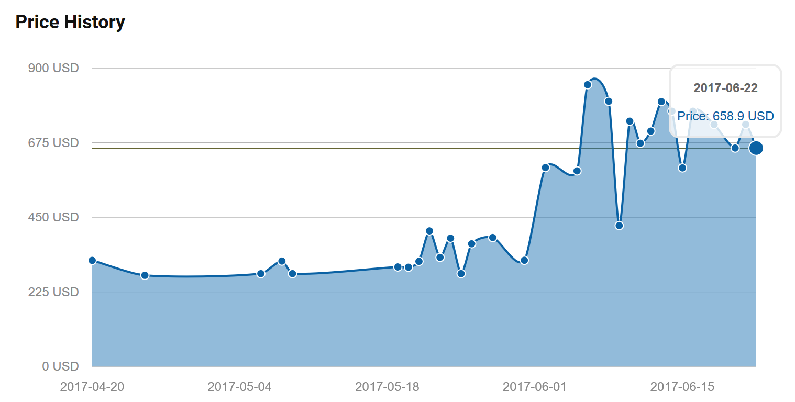
Proof of Work
Hash a block candidate until its hash, as a number, is lower than a certain constant
GPUs are good at hashing
Global shortage of GPUs (especially AMD)

Slide 14
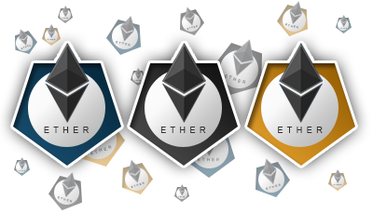
Proof of Stake
No hardware required
Participants place a “stake” - tokens of the currency
The creator of a block is determined in a random way
The size of the stake is proportional to the probability to be selected

Slide 15
Example
5 BGN to Gosho
Pesho
request
Network
Miners
Candidate block
Network
Gosho
Blockchain
New block
Yes
Block is valid?
5 BGN

Slide 16
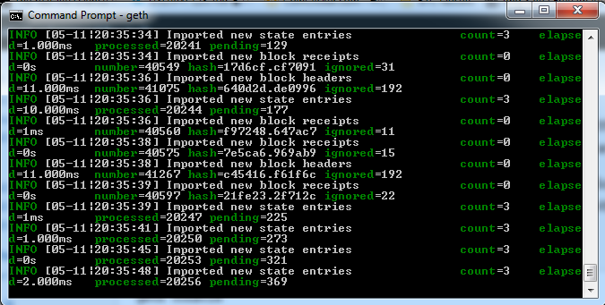
Blockchain node
To become a user, you must run a node
A node clones the blockchain and syncs with the network
The node can mine
You can create a public-private key pair and sign transactions

Slide 17
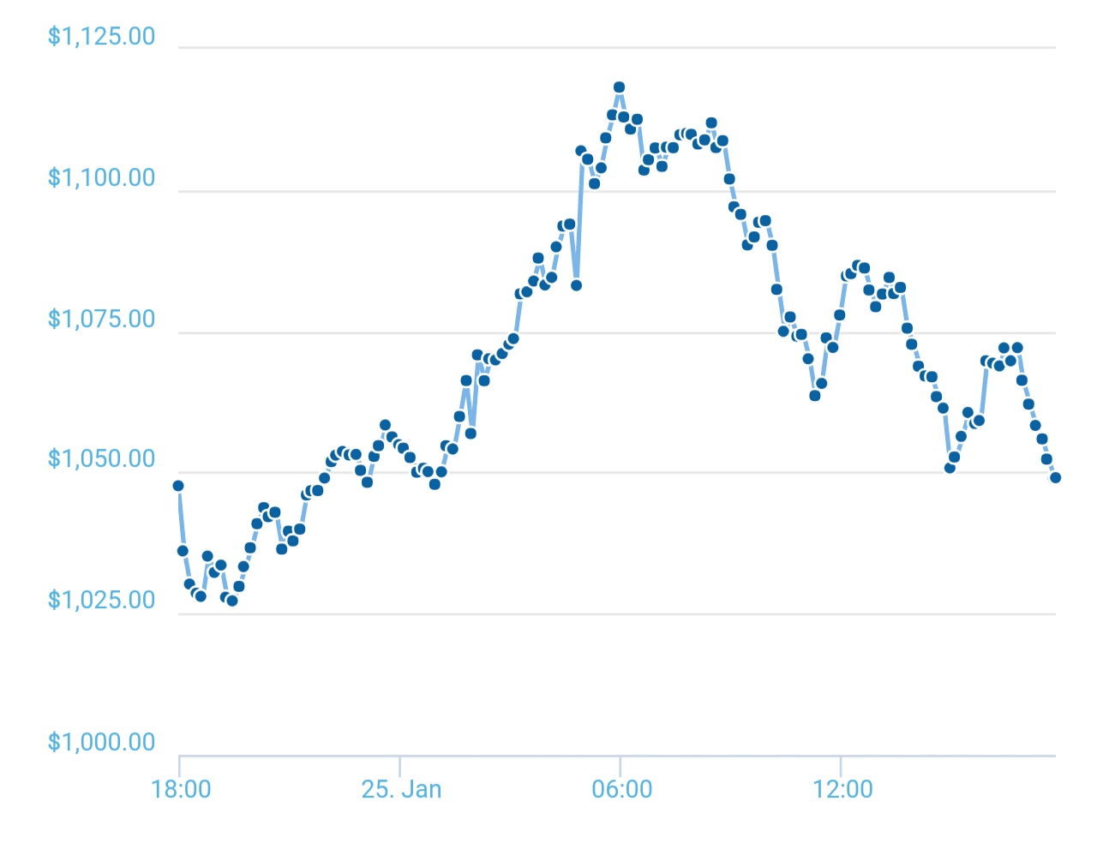
Reasons for volatility
Small market capitalization
Small user base
Speculative investment
Media influence
Altcoin influence
Hacks and attacks

Slide 18
The crazy around blockchian
Q: What is a quick way to raise funding?
A: Say “blockchain” quick enough until confused guys with suits start throwing money at you

Slide 19
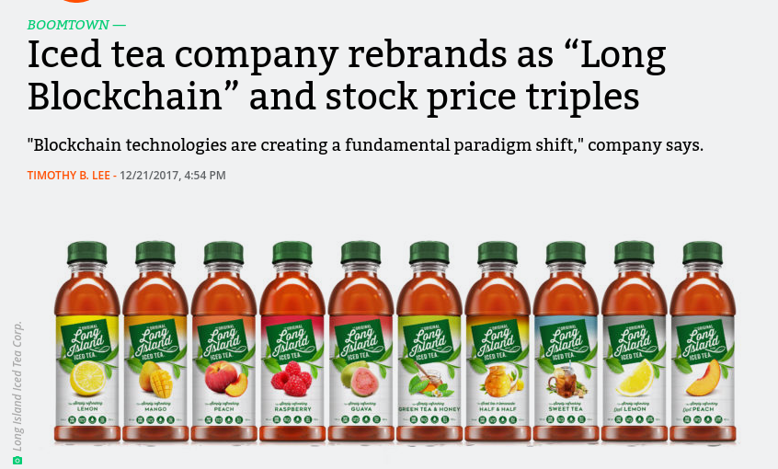

Slide 20
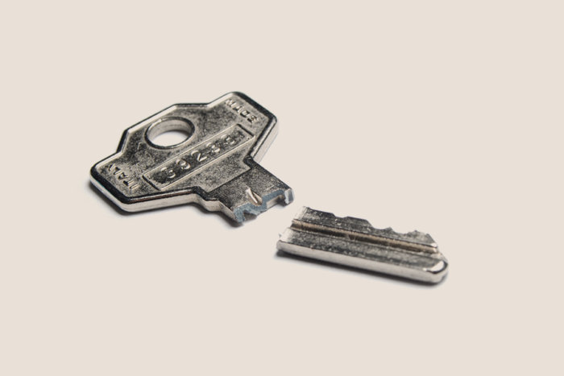
Problems of blockchain technology
Scalability / Throughput
Speed
Energy consumption
Publicity
Loss of private key
Protection from fraud
51% attack (Kind of fixed with PoS)

Slide 21
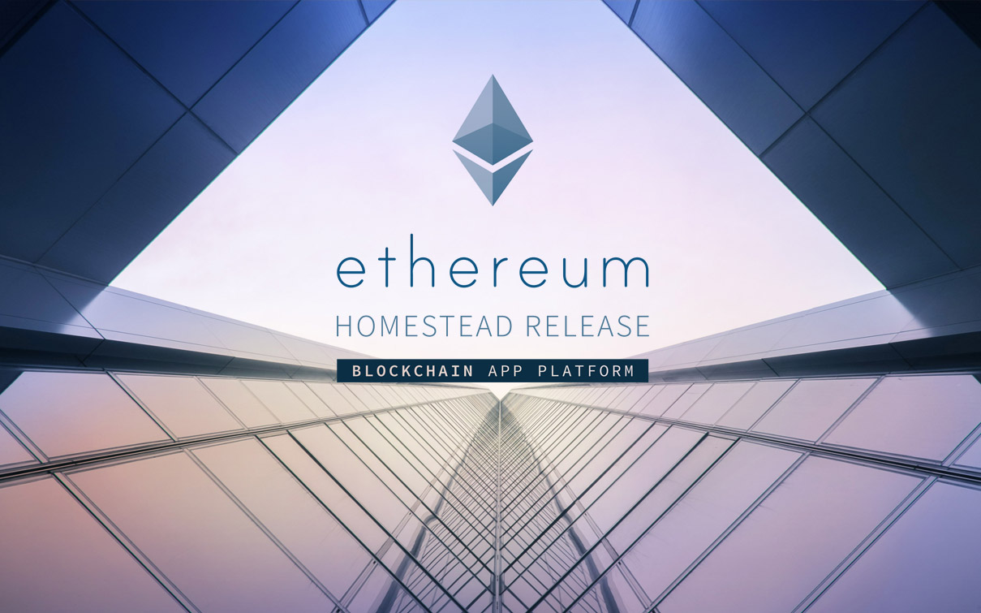
Въведение в Ehereum
Notes:
Платформа за създаване и изпълнение на блокчейн приложения, които обикновено биха изисквали чисто нов блокчейн и мрежа.

Slide 22
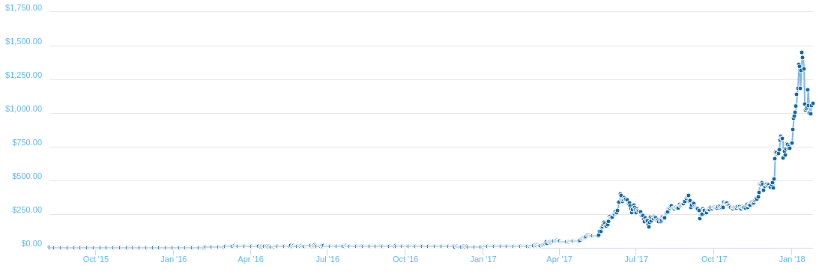
Notes:
Сега малко за Ethereum.

Slide 23
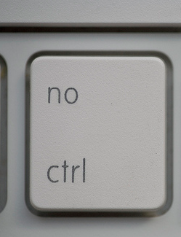
Decentralized applications
Code on the blockchain (turing complete)
Decentralized
Autonomous
Immutable
No censorship, control
„Contracts“
Notes:
Причината за този рязък скок са децентрализираните приложения.
Те са като сървър с 100% uptime, и никой не може да отиде и да ръгне флашката та да счупи нещата

Slide 24




Abilities
Data storage
Logic
ETH Balance
Multicontract interaction

Slide 25
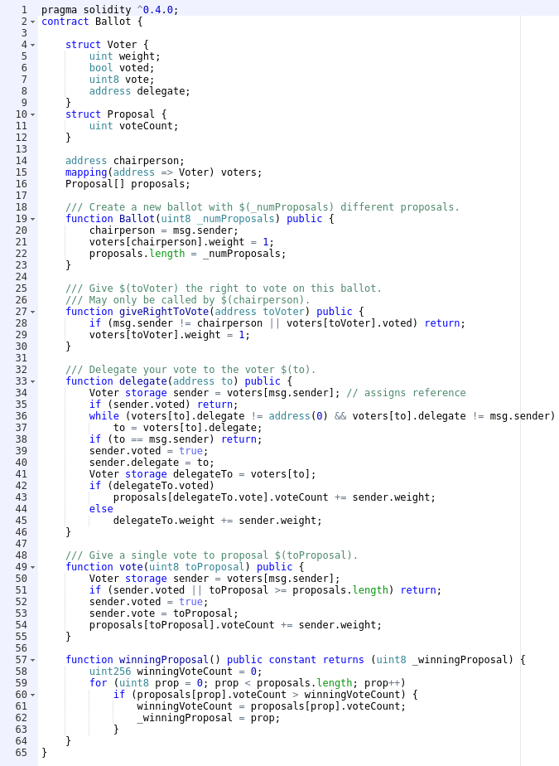

Slide 26

Do you really need a crypto contract?

Slide 27

Smart contract applications
Voting
Freedom of speech
Social networks
Crowdfunding
Token currencies

Slide 28

ICOs in a nutshell
Crowdfunding of projects
Public token sale

Slide 29
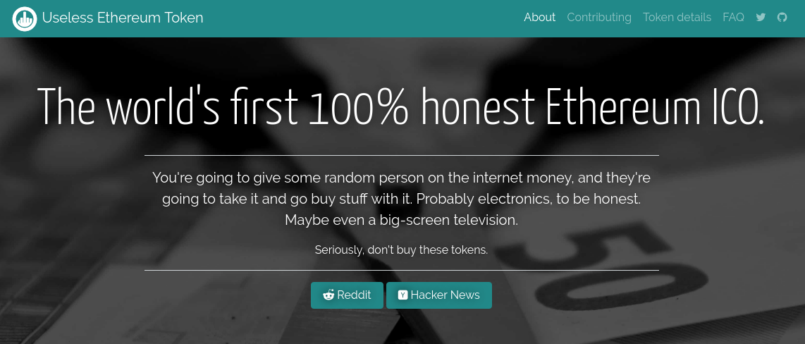
My favorite ICO - MUST BUY

Slide 30

Ethereum volatility
Bad for contracts
Execution costs can be hundreds of dollars

Slide 31
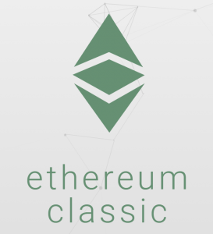
The DAO attack
June 17, 2016
Vulnerability in the DAO
Hacker drained $53M
Resulted in Hard fork
Split into Ethereum and Ethereum classic

Slide 32
Sep 19, 2016 DOS attack
Vulnerability in GETH
Caused a global crash
During devcon2

Slide 33
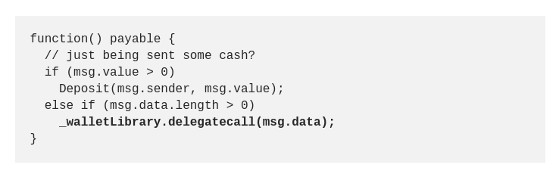
Parity Multi-sig wallet hack
Jul 19, 2017
Vulnerability in Parity’s Multi-sig wallet
150,000 ETH Stolen (~$30M at the time)
Never returned
Aeternity suffered major loss

Slide 34
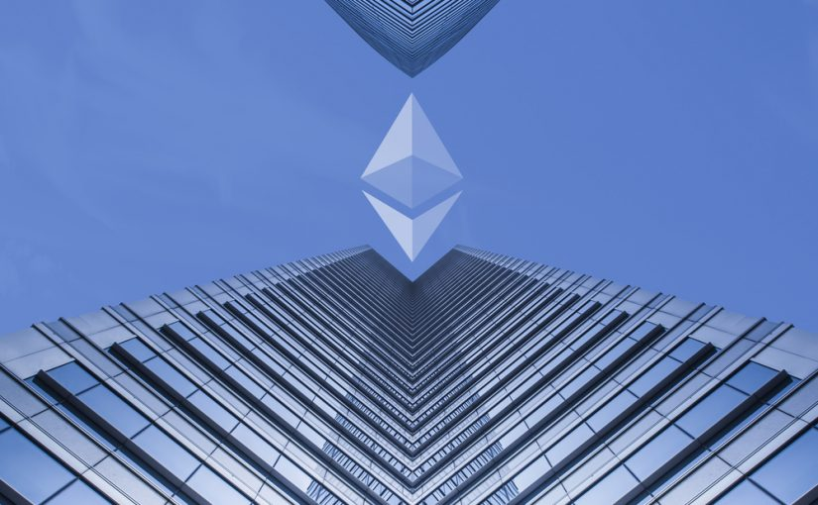
Upcoming Casper Update
Future fork
PoS consensus
Somewhere 2018
GPU Mining obsolete

Slide 35







Blockchain functionality summary
https://softuni.bg/trainings/1765/smart-contract-development-with-solidity#lesson-6813

